Slide 1

Forecasting, and Analyze digital currency
Name: Meshal Fahad Almubarak

Slide 2
Introduction
Organizing for the financial analysis process.
price of the digital currency will predict whether it will fall or rise in the future.
trader in the cryptocurrency market.
Building a model that uses the previous database
Why?
Goal:
Who?
How?

Slide 3
Steps before Model
Understanding the Problem.
Data Extraction.
Data Cleaning.
Exploratory Data Analysis.

Slide 4
characteristics/features for data
Close
Open
Low
Weighted Price.
High
Volume Currency
Volume BTC

Slide 5
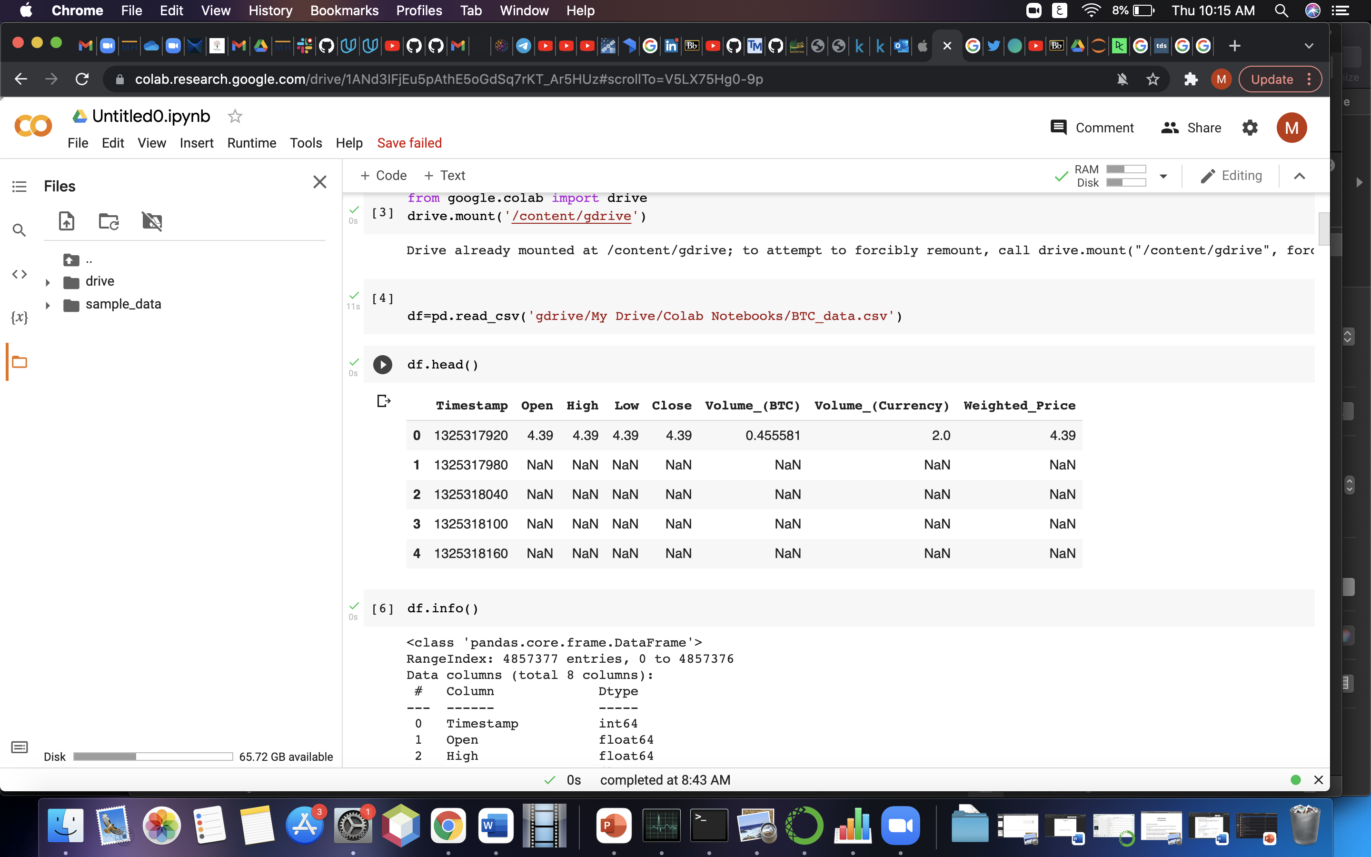
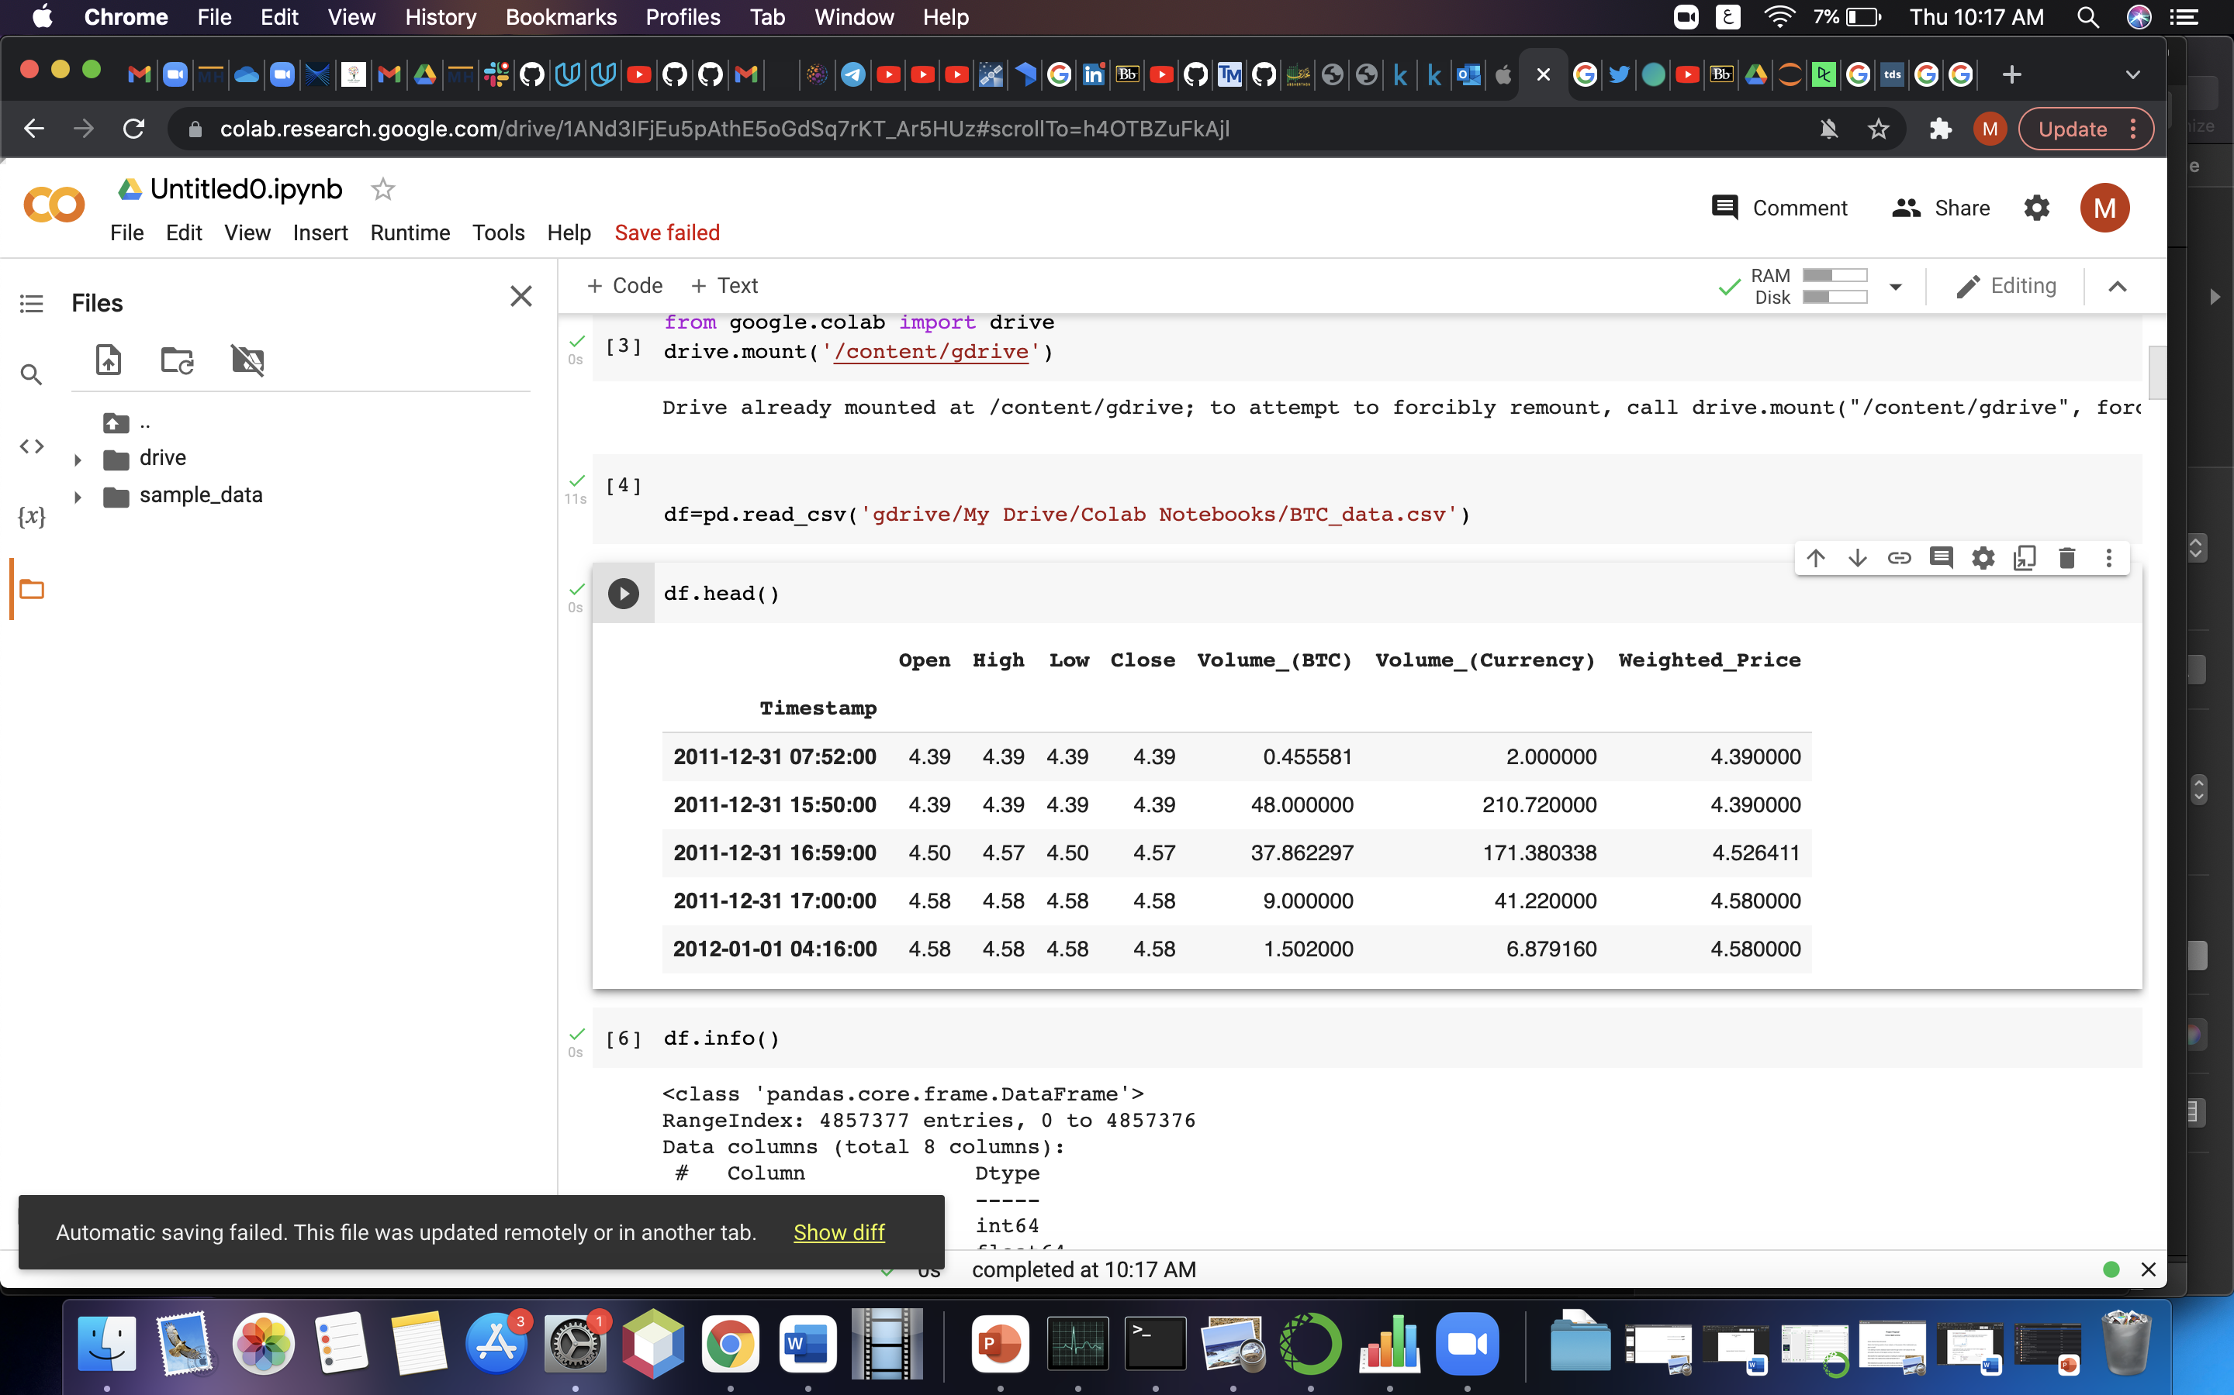
Data
4,857,377 rows
3,613,769 rows

Slide 6
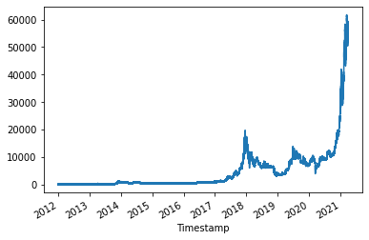
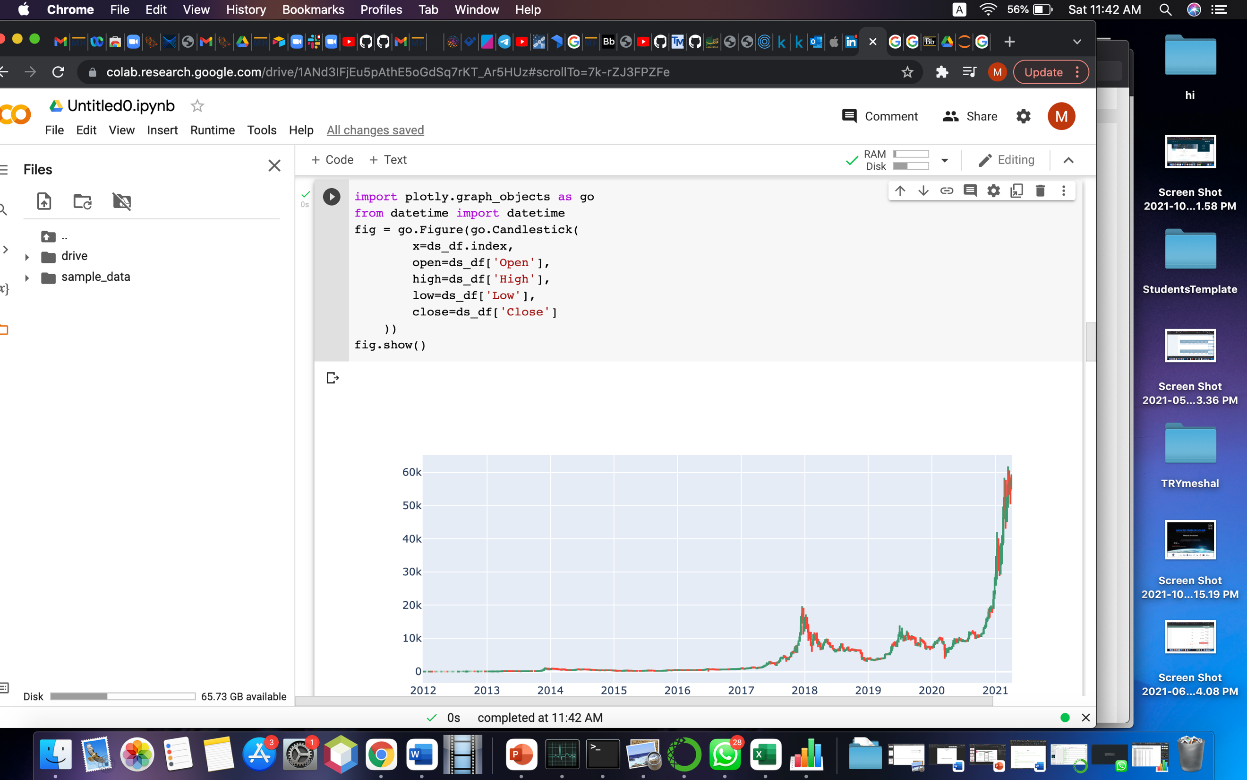
Data

Slide 7
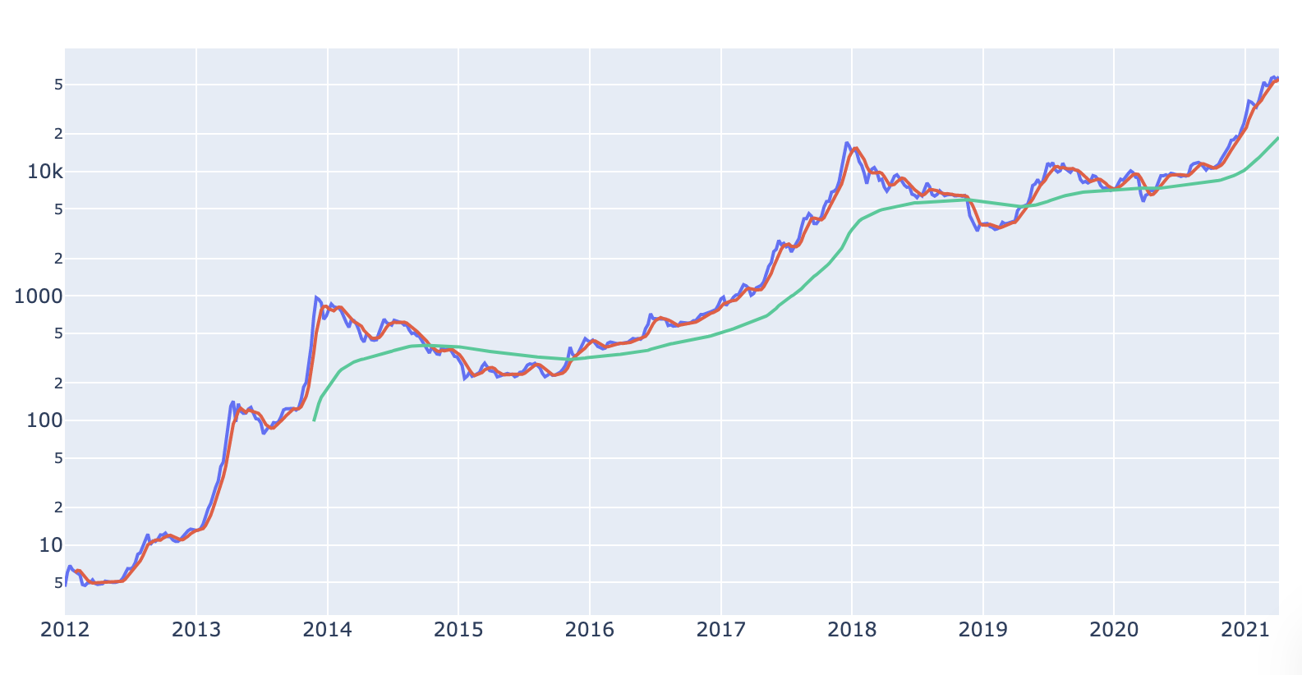
Data

Slide 8
Steps on Model
Feature Selection.
Incorporating Machine Learning Algorithms.
Testing the Models.
Check Results and Deploying the Model.

Slide 9
Modeling and Prediction
0.5397
accuracy
0.5129
F1 score
LSTM

Slide 10
prediction equation
Last 120 days
Find the result
Range of train

Slide 11
Project Development in Future
Train all data
Connect API
Try with a new arithmetic, and model

Slide 12
Thank You!

